Slide 1
Cognitive Graph for Understanding, Reasoning, and Decision
Jie Tang
Computer Science
Tsinghua University
The slides can be downloaded at http://keg.cs.tsinghua.edu.cn/jietang

Slide 2
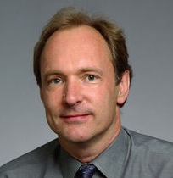
Knowledge Graph
“Knowledge graph” was used by Google in 2012
Knowledge engineering, expert system
CYC: the world's longest-lived AI project (1985)
Edward Feigenbaum
Father of KB
Turing Award
Tim Berners Lee
Father of WWW
Turing Award

Slide 3


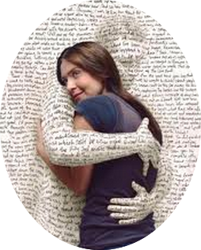







Networked World
2 billion MAU
26.4 billion minutes/day
>777 million trans. (alipay)
200 billion on 11/11
320 million MAU
Peak: 143K tweets/s
462 million users
influencing our daily life
700 million MAU
95 million pics/day
~1.5 billion MAU
70 minutes/user/day
300 million MAU
30 minutes/user/day
QQ: 860 million MAU
WeChat: 1.1 billion MAU
Notes:
http://www.digitaltrends.com/social-media/facebook-users-50-minutes/#:Tt28J4FGJlT5fA

Slide 4
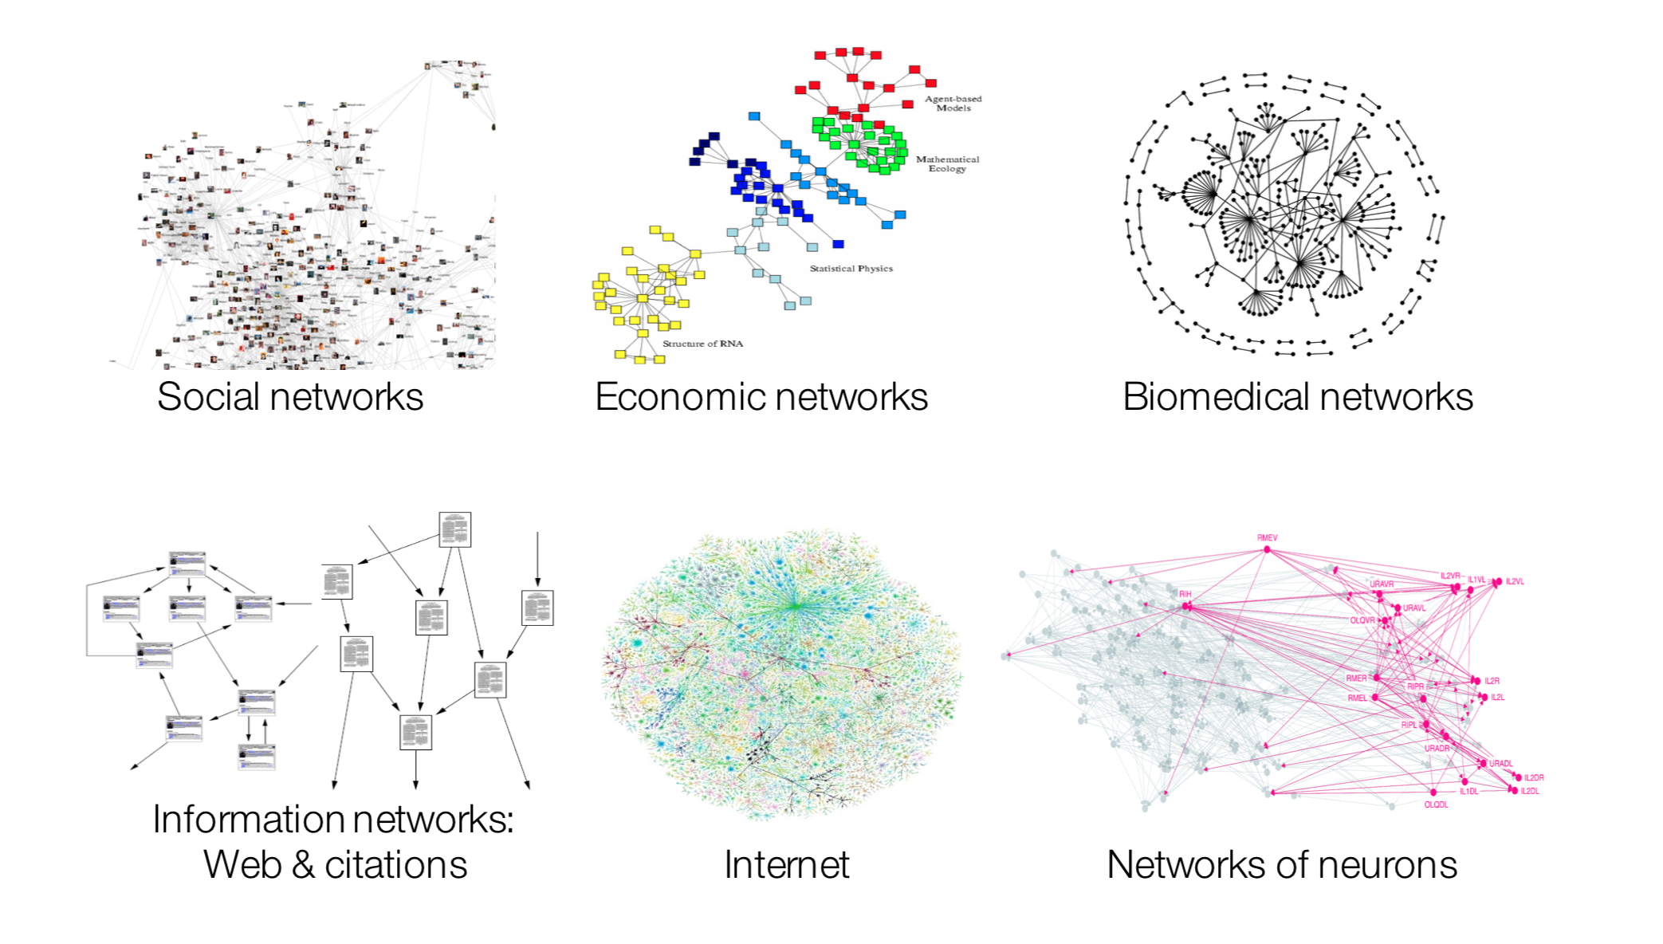
Many Data are Networks¹
Example from Jure’s slides

Slide 5
Machine Learning with Networks
ML tasks in networks:
Node classification
Predict a type of a given node
Link prediction
Predict whether two nodes are linked
Community detection
Identify densely linked clusters of nodes
Network similarity
How similar are two (sub)networks?

Slide 6
Let us start with a challenging question —Multi-hop Question Answering (QA)

Slide 7

Multi-hop QA
Quality Café
Los Angeles
Alessandro Moschitti
The Quality Cafe is a now-defunct diner in Los Angeles, California. The restaurant has appeared as a location featured in a number of Hollywood films, including Old School, Gone in 60 Seconds, ...
Los Angeles is the most populous city in California, the second most populous city in the United States, after New York City, and the third most populous city in North America.
Alessandro Moschitti is a professor of the CS Department of the University of Trento, Italy. He is currently a Principal Research Scientist of the Qatar Computing Research Institute (QCRI)
Old School
Todd Phillips
Tsinghua University
Old School is a 2003 American comedy film released by Dream Works Pictures and The Montecito Picture Company and directed by Todd Phillips.
Todd Phillips is an American director, producer, screenwriter, and actor. He is best known for writing and directing films, including Road Trip (2000), Old School (2003), Starsky & Hutch (2004), and The Hangover Trilogy.
Tsinghua University is a major research university in Beijing and dedicated to academic excellence and global development. Tsinghua is perennially ranked as one of the top academic institutions in China, Asia, and worldwide...

Slide 8
Challenge 1: Myopic Retrieval Problem
Document A
Old School is a 2003 American comedy film released by DreamWorks Pictures and The Montecito Picture Company…
Document B
Many directors shoot scenes in Hollywood, Los Angeles, which is notable as the home of the U.S. film industry.
However in multi-hop QA, paragraphs multiple hops away from the question could share few common words with the question, leading to a failed retrieval.

Slide 9
Challenge 2: Explainability
Most RC models can only be seen as black-boxes:
Input: The question and a paragraph
Output: The answer span (start and end positions)
To enable a verification by the user, we need:
The reasoning path (graph)
The supporting facts (sentences) at each hop
Other possible answers and their reasoning paths for comparison

Slide 10

Cognitive Graph: Representation, Reasoning, and Decision
Notes:
Imagine a scenario where you have a wikipedia to look up for any entity, and how can you answer such a question?(click)
Question…
We will first search quality café and los angeless which seems useful for answering the question. Okay there are two quality café but we find CLUES in the middle one there are two films featured here. And then we read the paragraph in wiki about the two films and find out there directors.
Now, we construct a graph step by step, which includes all possible and userful information. And our brain will analyze the whole information and gives the final answer.
We name this graph “cognitive graph”.

Slide 11
Connecting to Cognitive Science
System 1
Intuitive
System 2
Analytic
Dual Process Theory
Jonathan St BT Evans. 1984. Heuristic and analytic processes in reasoning. British Journal of Psychology, 75(4):451–468.

Slide 12
Reasoning w/ Cognitive Graph
System 1:
Knowledge expansion by association in text when reading
System 2:
Decision making w/ all the information
System 1
Intuitive
System 2
Analytic
Notes:
Dual process theory in cognition science says:

Slide 13

CogQA: Cognitive Graph for QA
An iterative framework corresponding to dual process theory
System 1
extract entities to build the cognitive graph
generate semantic vectors for each node
System 2
Do reasoning based on semantic vectors and graph
Feed clues to System 1 to extract next-hop entities
System 1
extract
Question
Cognitive Graph
input
Quality café
Los Angeles
…location featured in a number of Hollywood films, including Old School, Gone in 60 Seconds…
clues
Old school
Gone in 60 seconds
System 2
input
Todd Phillips
Dominic Sena
predict

Slide 14
Q1: How to represent a concept in a graph?

Slide 15
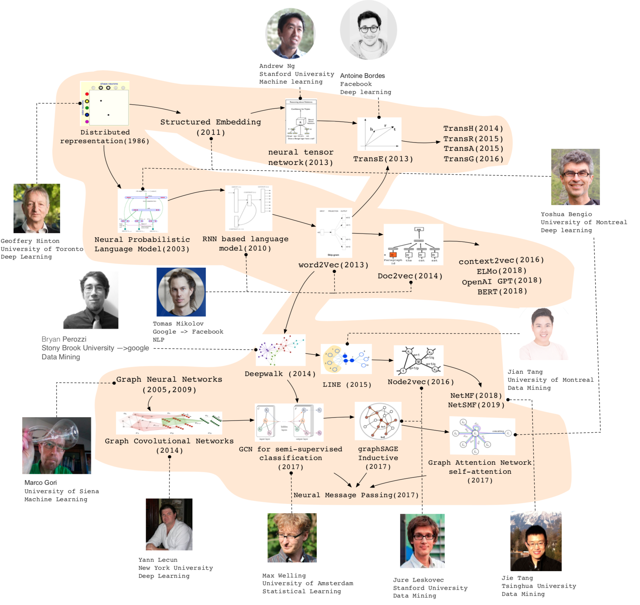

Slide 16
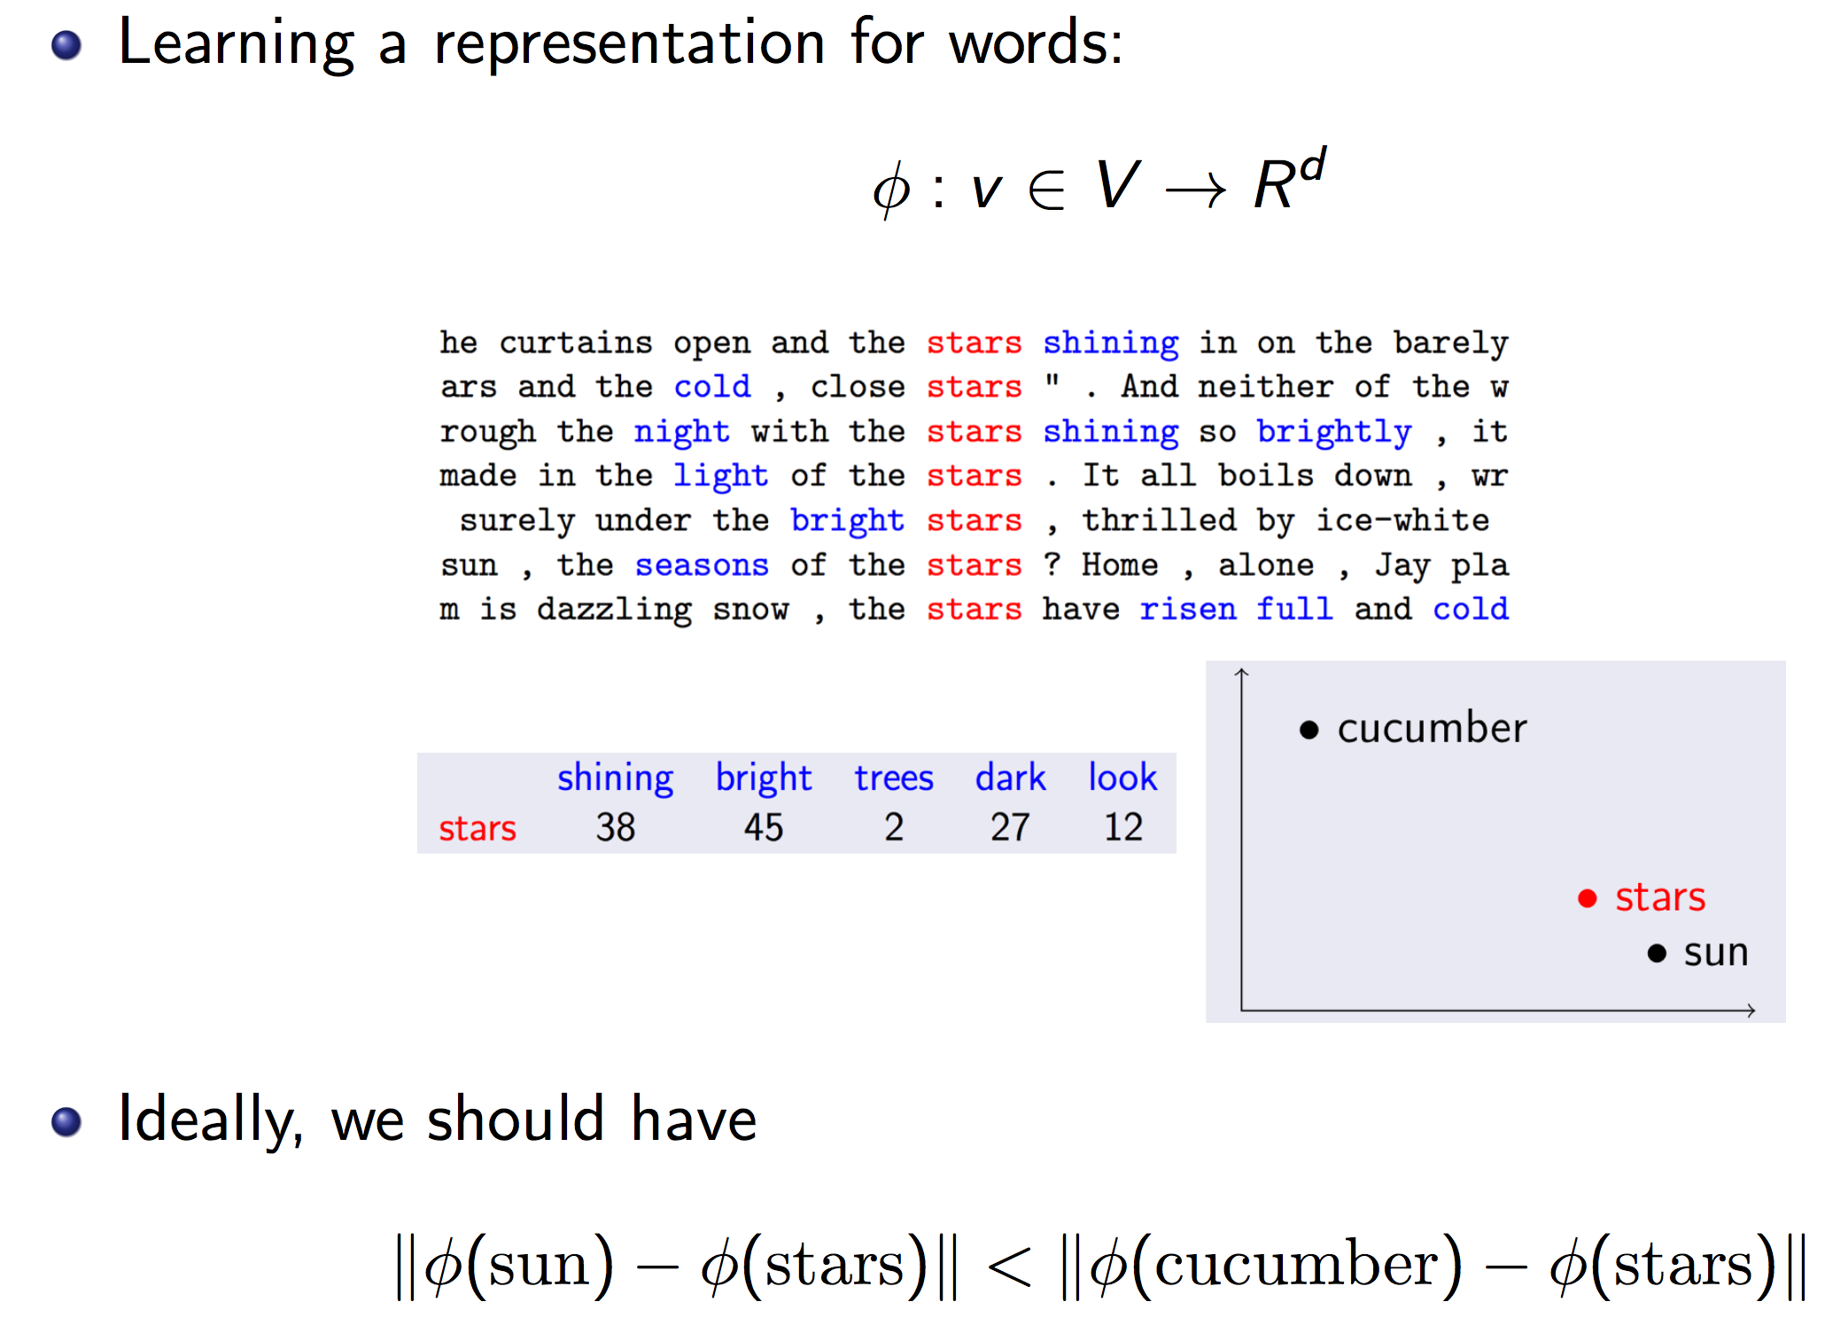
Recall word2vec for NLP

Slide 17





Review Representation Learning for Graphs
d-dimensional vector, d<<|V|
Representation Learning/ Graph Embedding
0.8
0.2
0.3
…
0.0
0.0
Users with the same label are located in the d-dimensional space closer than those with different labels
e.g., node classification
label2
label1

Slide 18
Why is it hard?
Modern deep learning toolbox is designed for simple sequences or grids.
CNNs for fixed-size images/grids...
RNNs or word2vec for text/sequences...
But networks are far more complex!
Complex topographical structure (i.e., no spatial locality like grids)
No fixed node ordering or reference point (i.e., the isomorphism problem)
Often dynamic and have multimodal features.

Slide 19
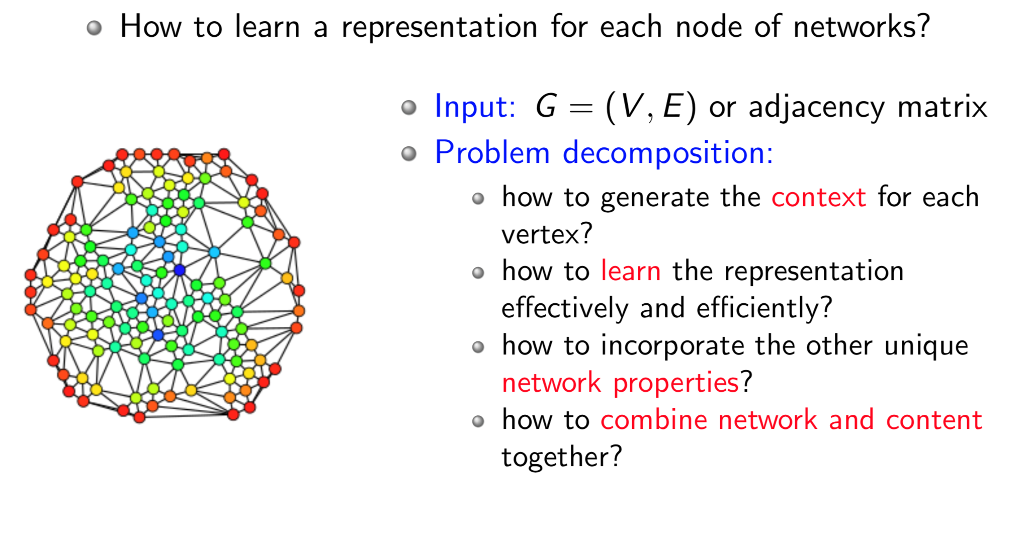
Node Embeddings

Slide 20
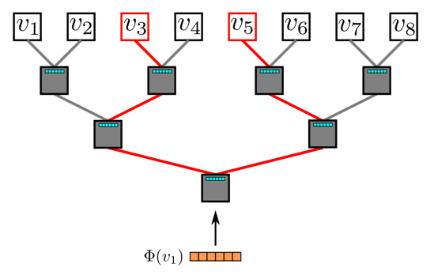
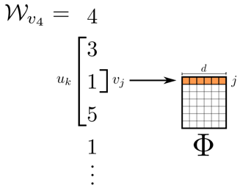
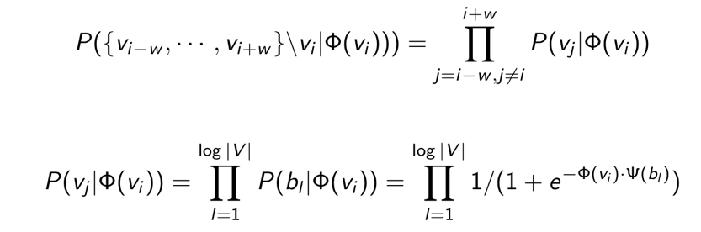
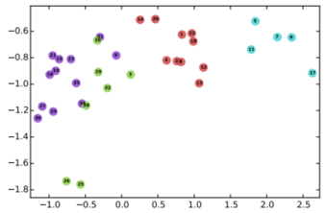
DeepWalk
Random walk
One example RW path
SkipGram with Hierarchical softmax
v₃
v₄
v₄
v₃
v₁
v₅
v₆
v₁
v₅
v₂
v₆
Hierarchical softmax
B. Perozzi, R. Al-Rfou, and S. Skiena. 2014. Deepwalk: Online learning of social representations. KDD, 701–710.

Slide 21
DeepWalk
Random walk
One example RW path
SkipGram with Hierarchical softmax
v₃
v₄
v₄
v₃
v₁
v₅
v₆
v₁
v₅
v₂
v₆
Hierarchical softmax
B. Perozzi, R. Al-Rfou, and S. Skiena. 2014. Deepwalk: Online learning of social representations. KDD, 701–710.

Slide 22
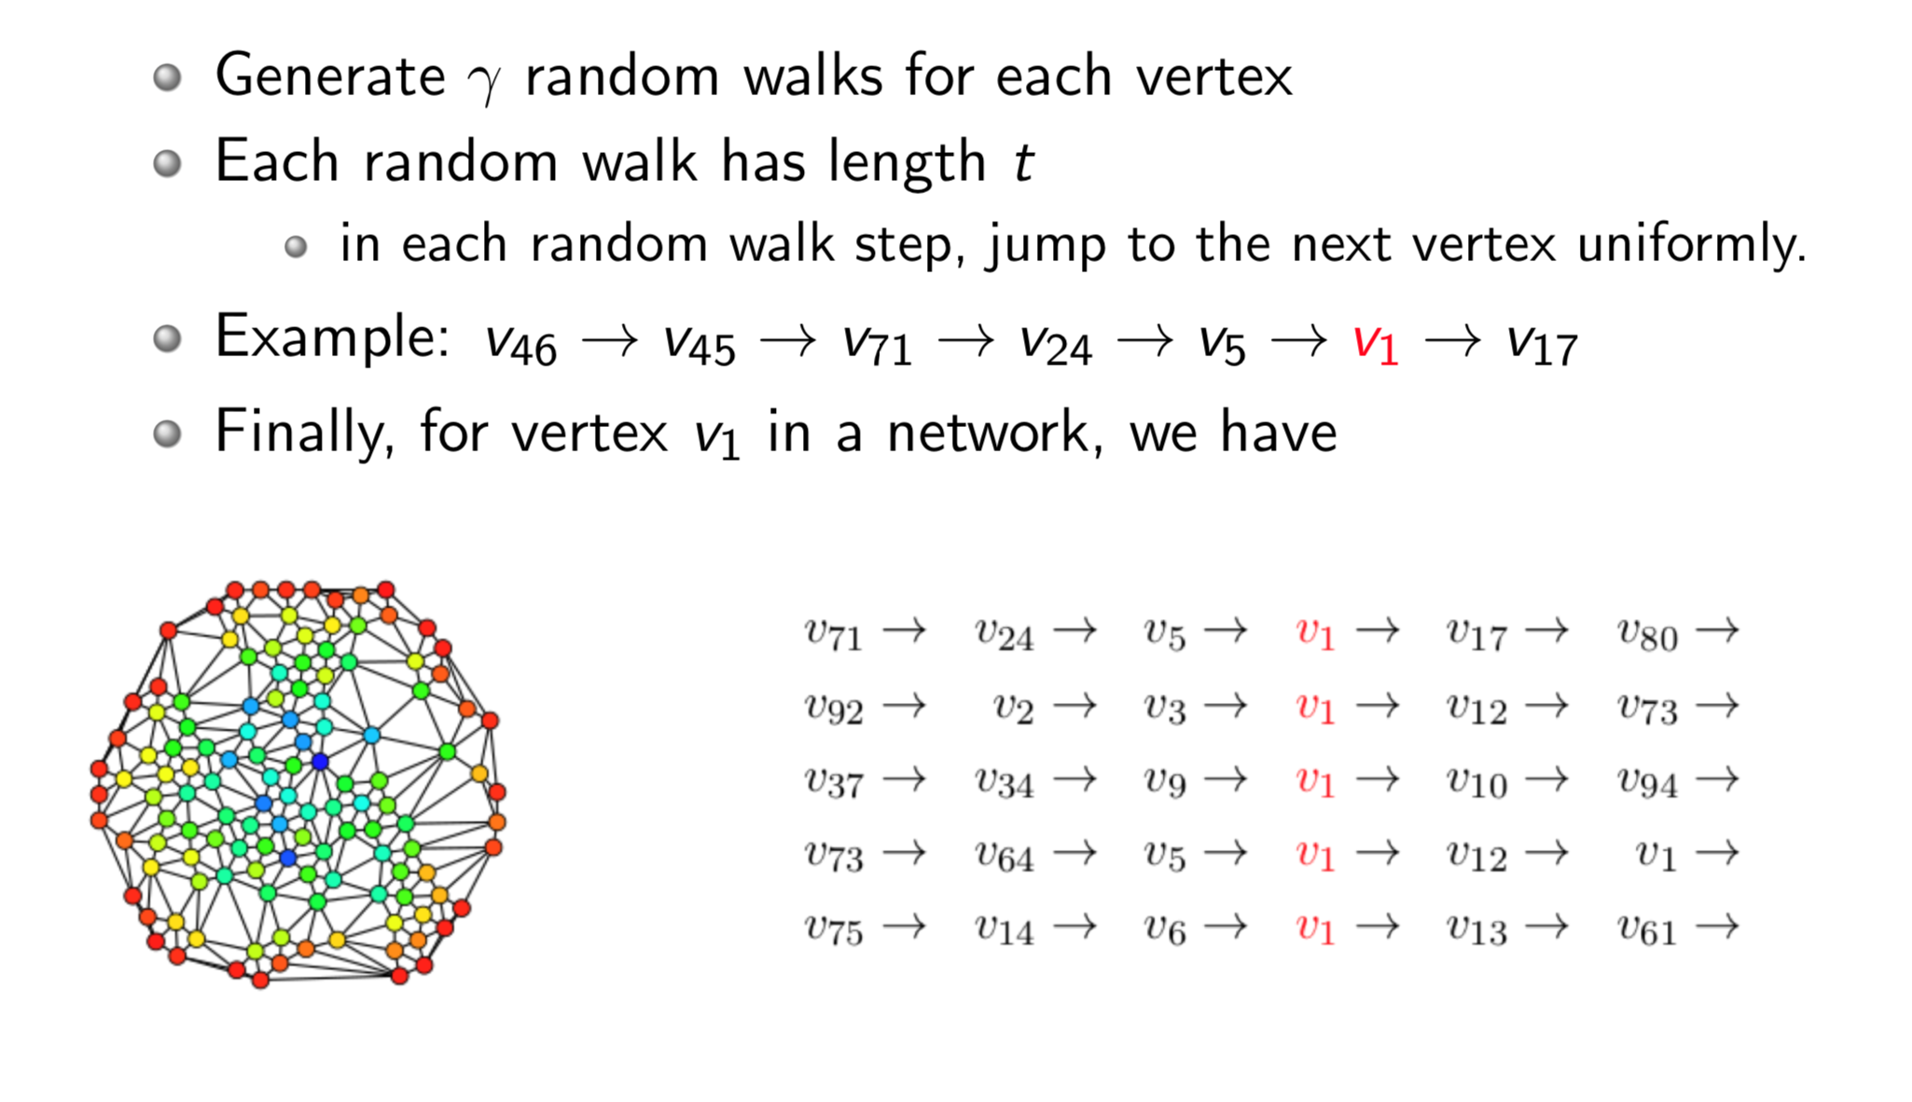
Random Walk

Slide 23
DeepWalk
Random walk
One example RW path
SkipGram with Hierarchical softmax
v₃
v₄
v₄
v₃
v₁
v₅
v₆
v₁
v₅
v₂
v₆
Hierarchical softmax
B. Perozzi, R. Al-Rfou, and S. Skiena. 2014. Deepwalk: Online learning of social representations. KDD, 701–710.

Slide 24
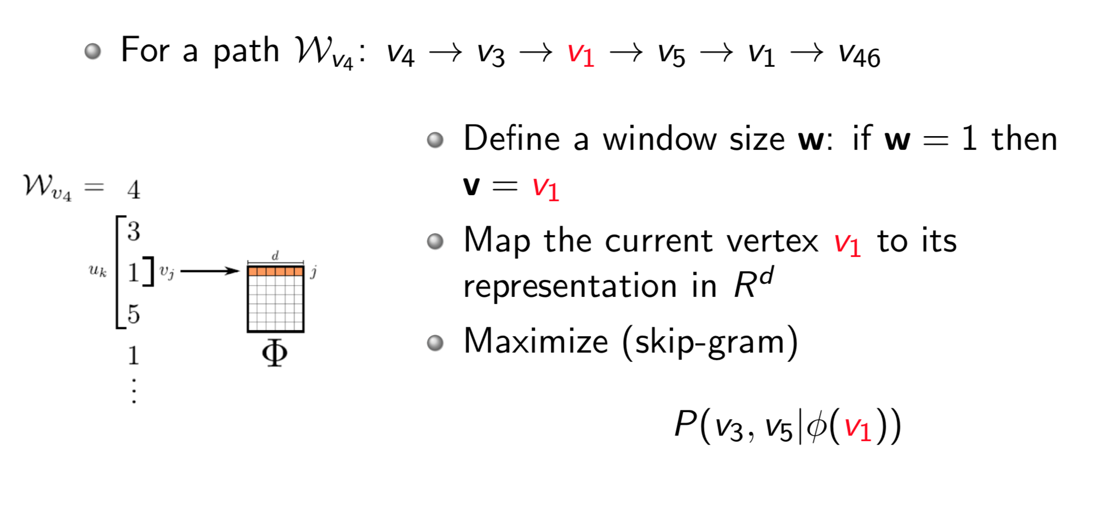
Representation Mapping

Slide 25
DeepWalk
Random walk
One example RW path
SkipGram with Hierarchical softmax
v₃
v₄
v₄
v₃
v₁
v₅
v₆
v₁
v₅
v₂
v₆
Hierarchical softmax
B. Perozzi, R. Al-Rfou, and S. Skiena. 2014. Deepwalk: Online learning of social representations. KDD, 701–710.

Slide 26
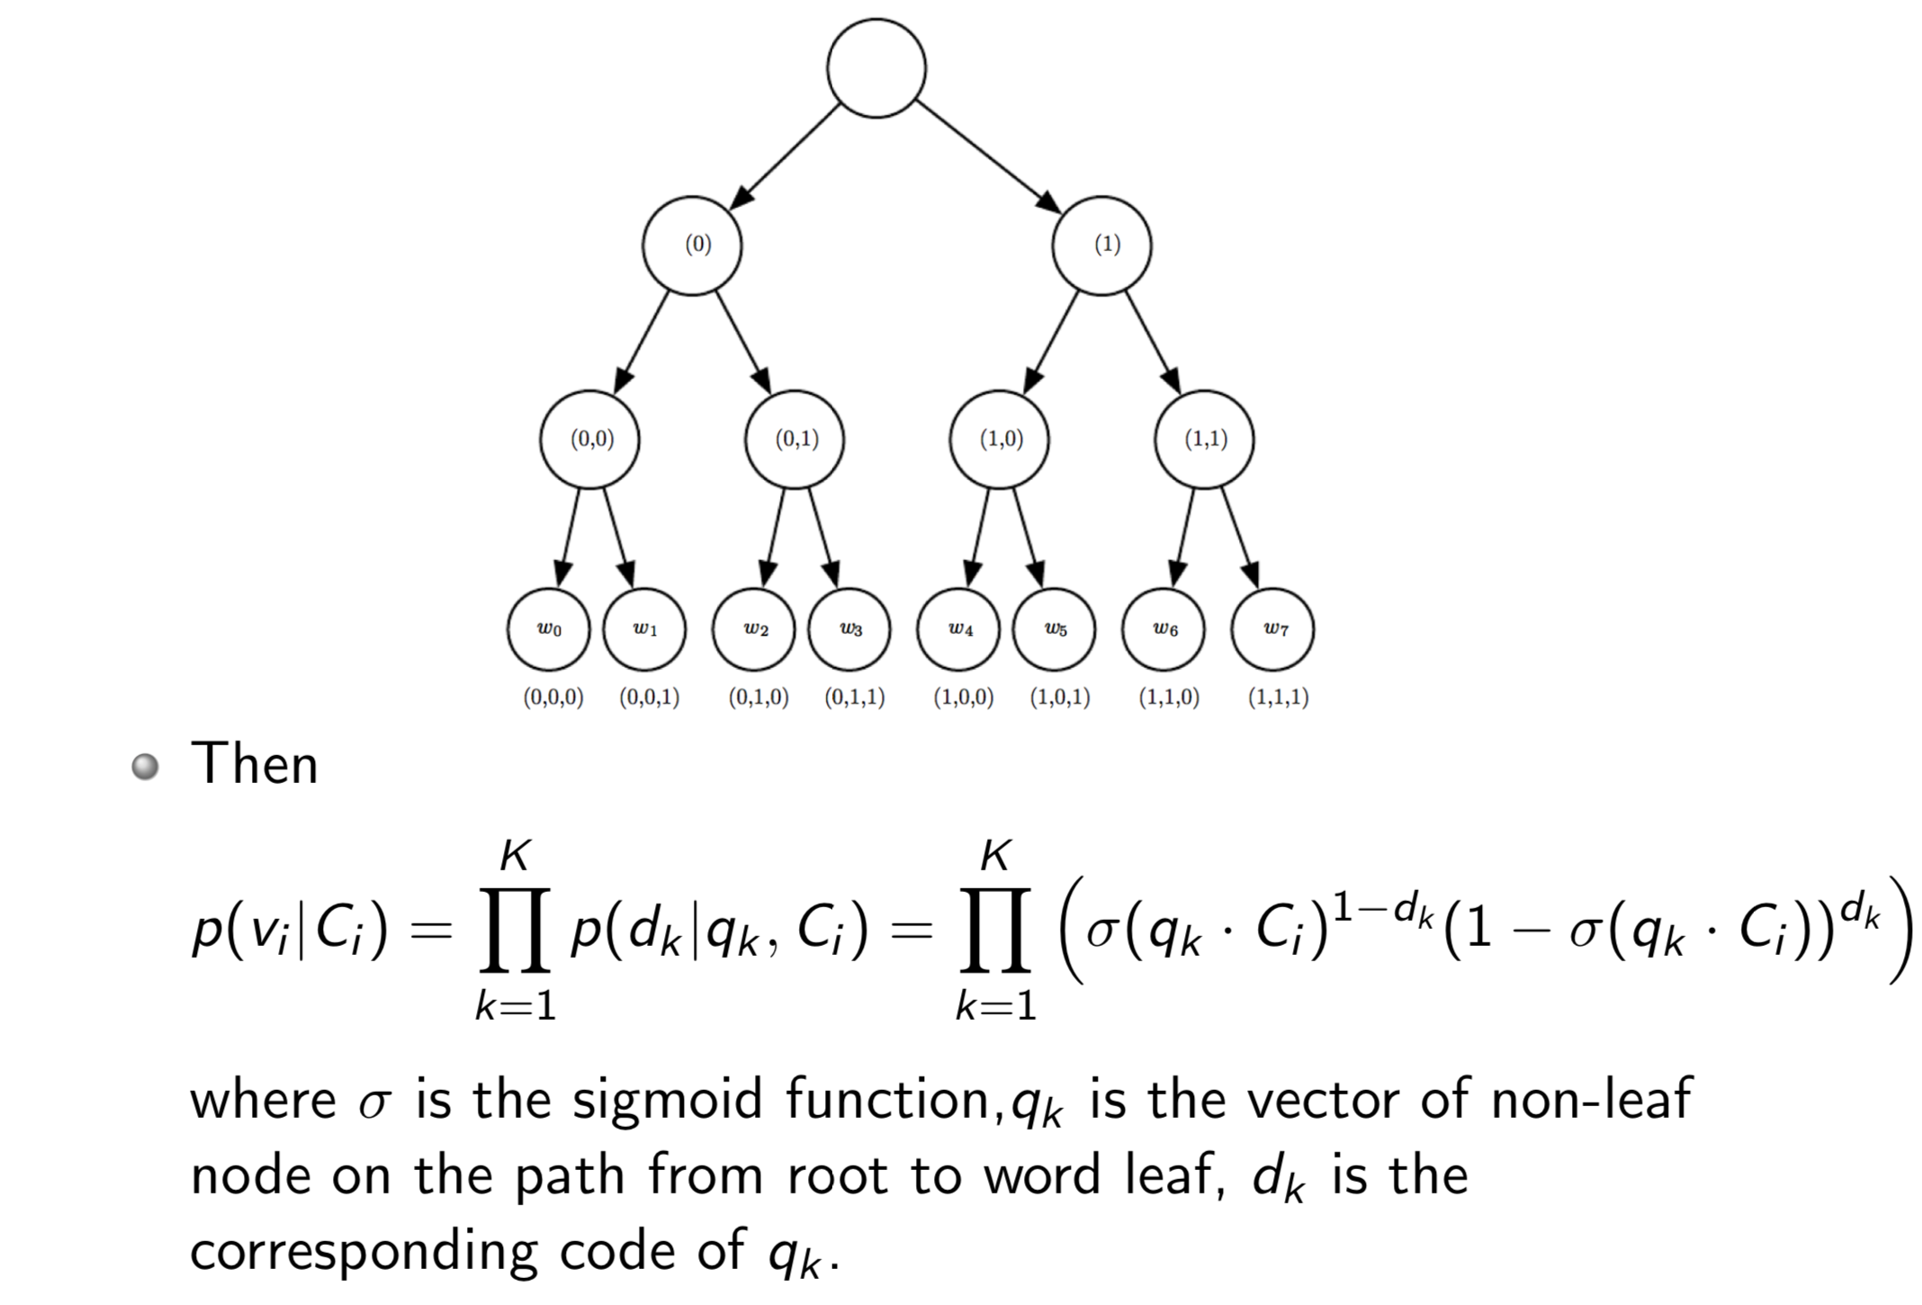
Hierarchical Softmax

Slide 27
Parameter Learning
Randomly initialize the representations
Each classifier in the hierarchy has a set of weights
Use SGD (stochastic gradient descent) to update both classifier weights and vertex representations simultaneously

Slide 28
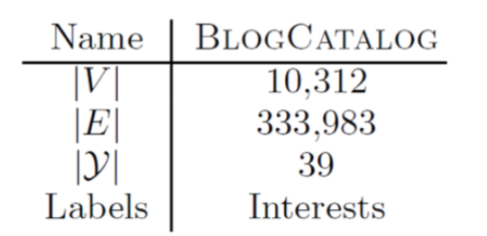
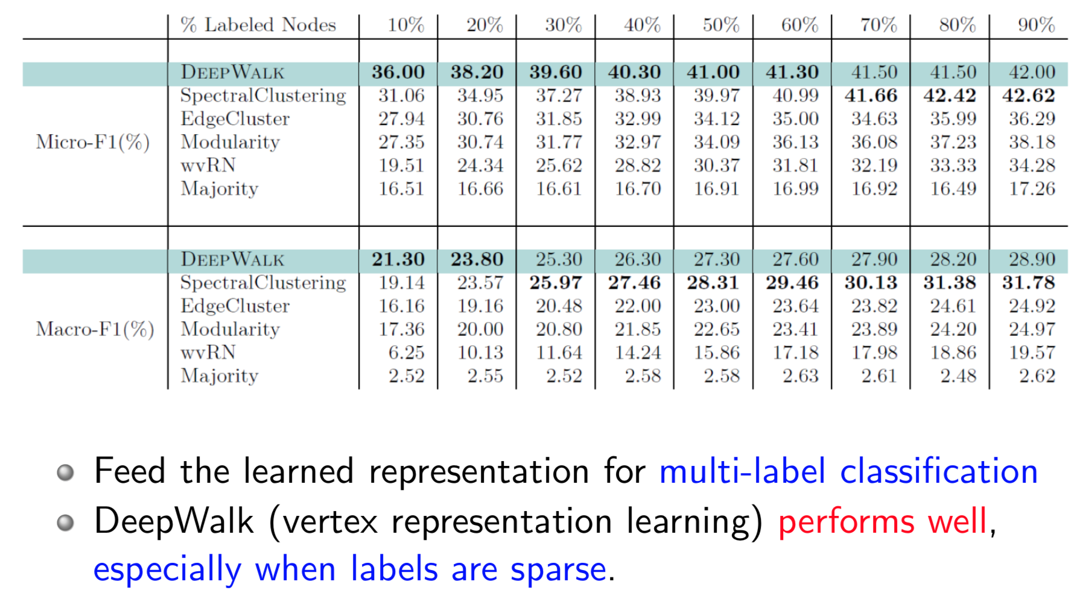
Results: BlogCatalog

Slide 29
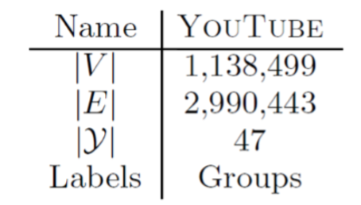
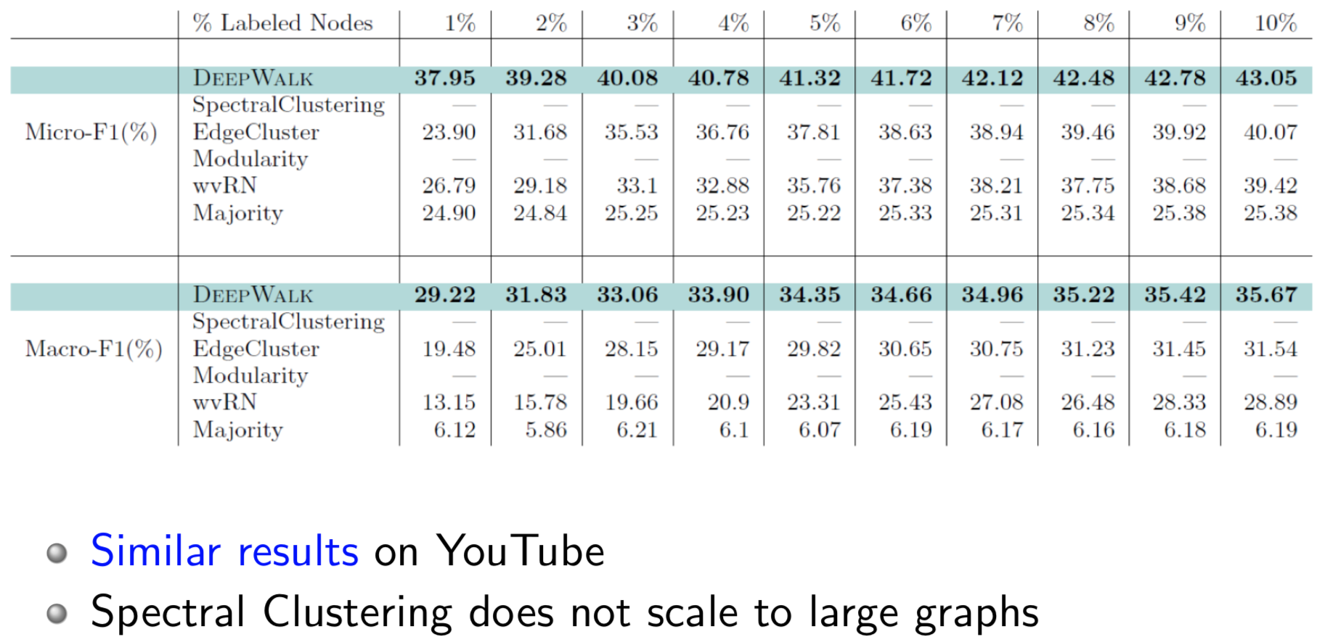
Results: YouTube

Slide 30
DeepWalk utilizes fixed-length, unbiased random walks to generate context for each node, can we do better?

Slide 31
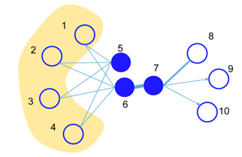
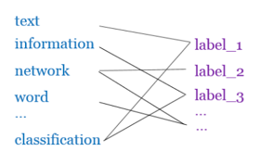
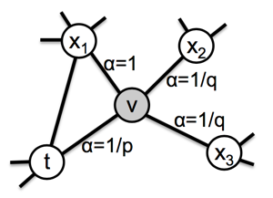
Later…
LINE^{[1]}: explicitly preserves both first-order and second-order proximities.
PTE^{[2]}: learn heterogeneous text network embedding via a semi-supervised manner.
Node2vec^{[3]}: use a biased random walk to better explore node’s neighborhood.
J. Tang, M. Qu, M. Wang, M. Zhang, J. Yan, and Q. Mei. 2015. Line: Large-scale information network embedding. WWW, 1067–1077.
J. Tang, M. Qu, and Q. Mei. 2015. Pte: Predictive text embedding through large-scale heterogeneous text networks. KDD, 1165–1174.
A. Grover and J. Leskovec. 2016. node2vec: Scalable feature learning for networks. KDD, 855–864.

Slide 32
Questions
What are the fundamentals underlying the different models?
or
Can we unify the different graph embedding approaches?

Slide 33
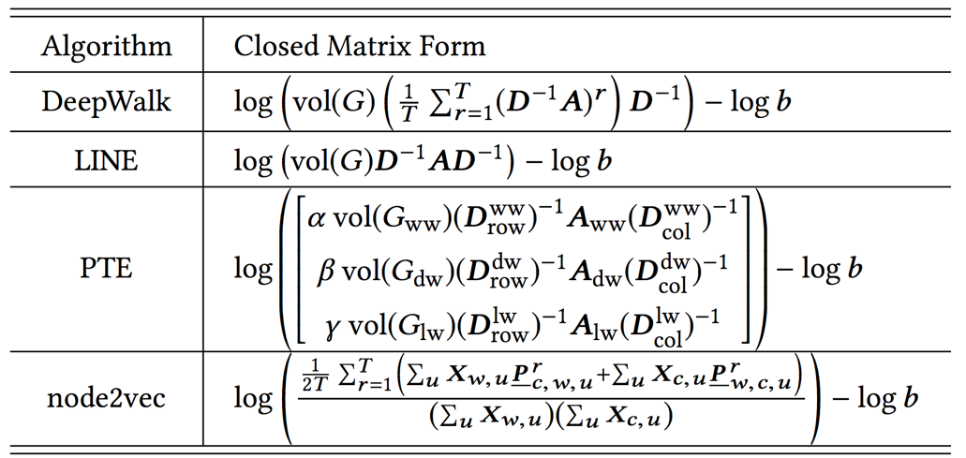
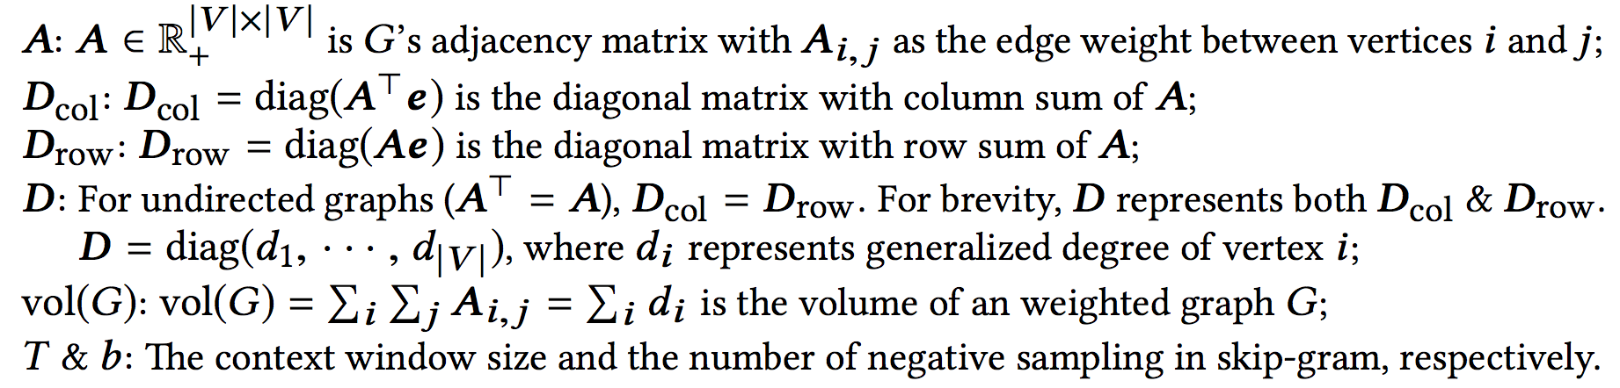
Unifying DeepWalk, LINE, PTE, and node2vec into Matrix Forms
Qiu et al. Network embedding as matrix factorization: unifying deepwalk, line, pte, and node2vec. WSDM’18. The most cited paper in WSDM’18 as of May 2019

Slide 34
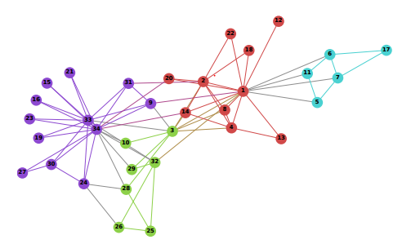
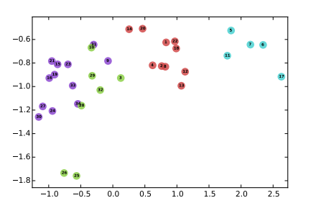
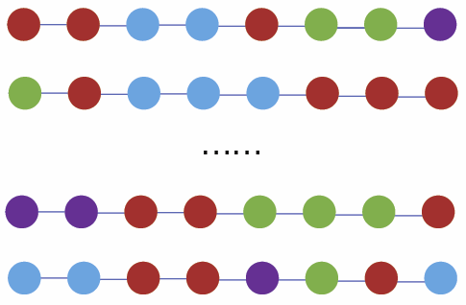
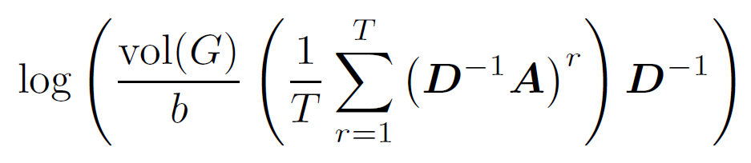
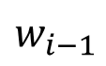

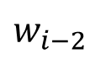
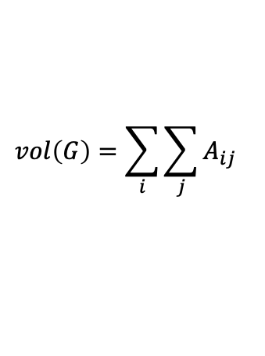
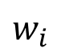
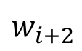
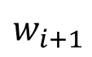

DeepWalk is factorizing a matrix
Matrix Factorization
$$w_{i−2 }$$
$$w_{i−1 }$$
$$w_{i}$$
$$w_{i+1 }$$
$$w_{i+2 }$$
DeepWalk is asymptotically and implicitly factorizing
$$vol\left(G\right)=\sum_{i}{\sum_{j}{A_{ij}}}$$
$$A$$
Adjacency matrix
b: #negative samples
T: context window size
$$D$$
Degree matrix

Slide 35
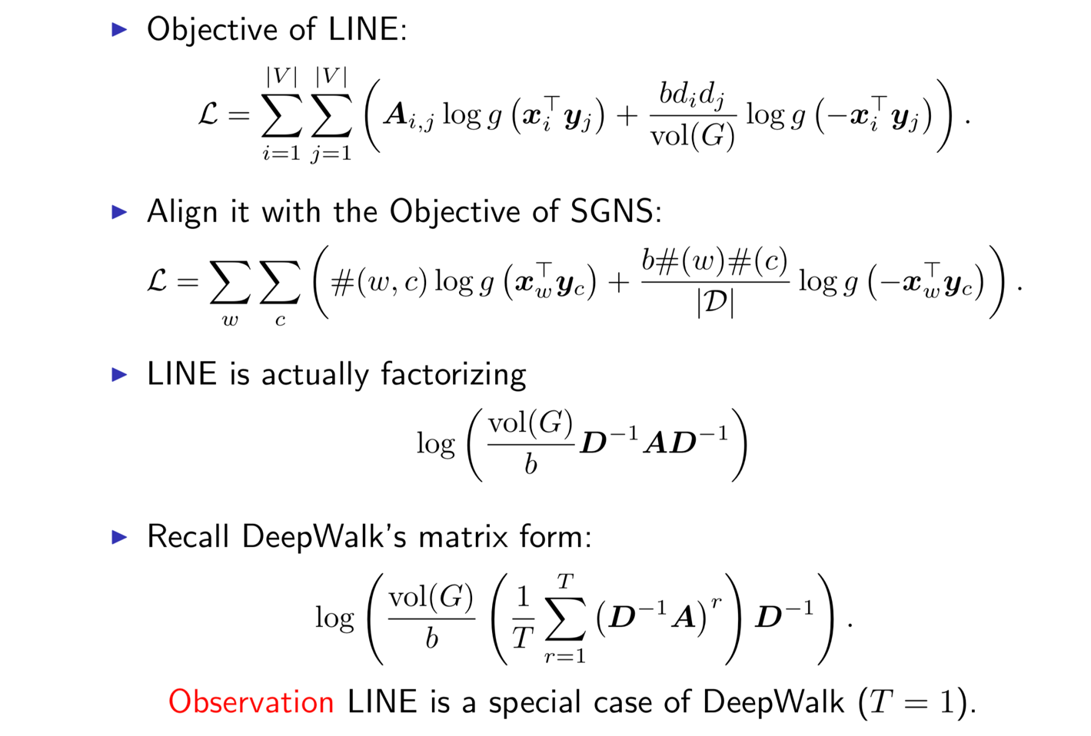
LINE

Slide 36
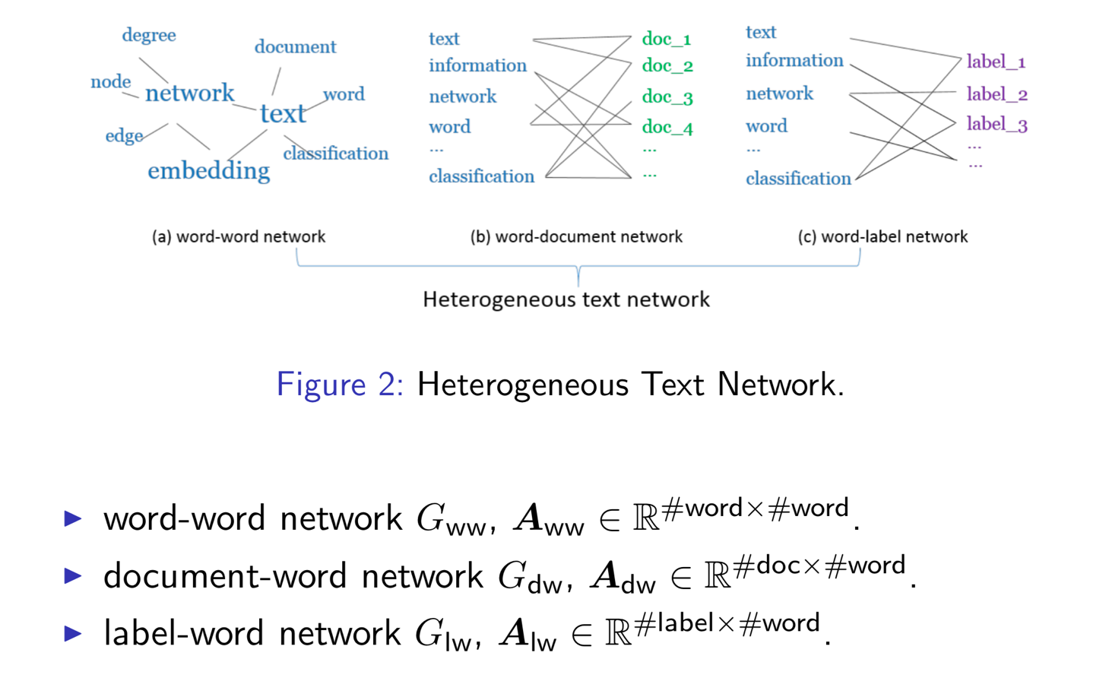
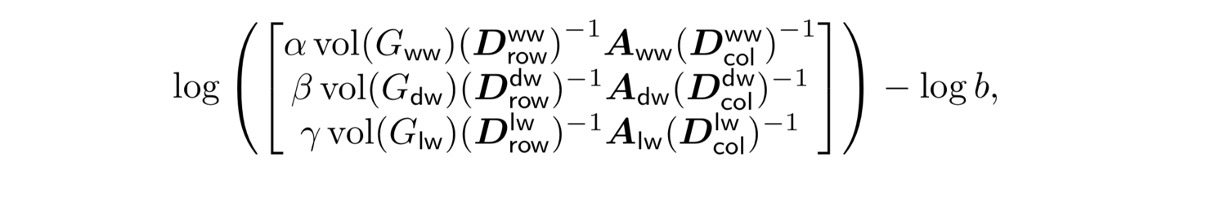
PTE

Slide 37
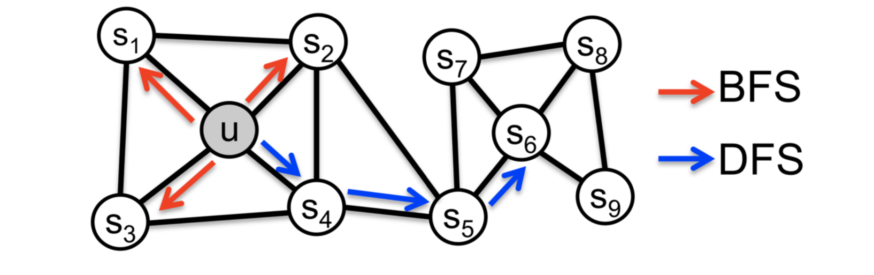
node2vec: Biased Walks
Use biased random walks to trade off local and global views of the network
Biased walks is a special case of random walk, thus node2vec is a special case of DeepWalk
A. Grover and J. Leskovec. 2016. node2vec: Scalable feature learning for networks. KDD, 855–864.

Slide 38
Unifying DeepWalk, LINE, PTE, and node2vec into Matrix Forms
Qiu et al. Network embedding as matrix factorization: unifying deepwalk, line, pte, and node2vec. WSDM’18. The most cited paper in WSDM’18 as of May 2019

Slide 39
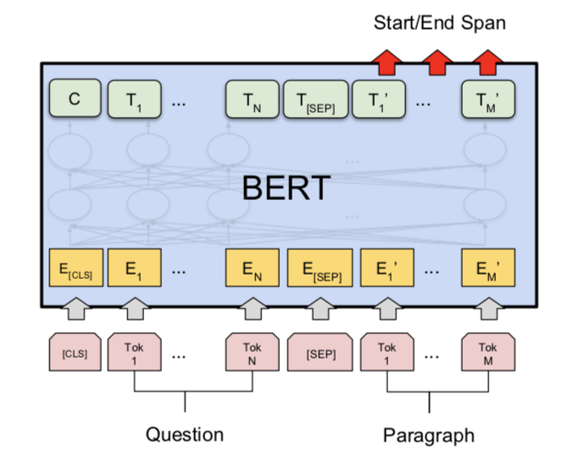
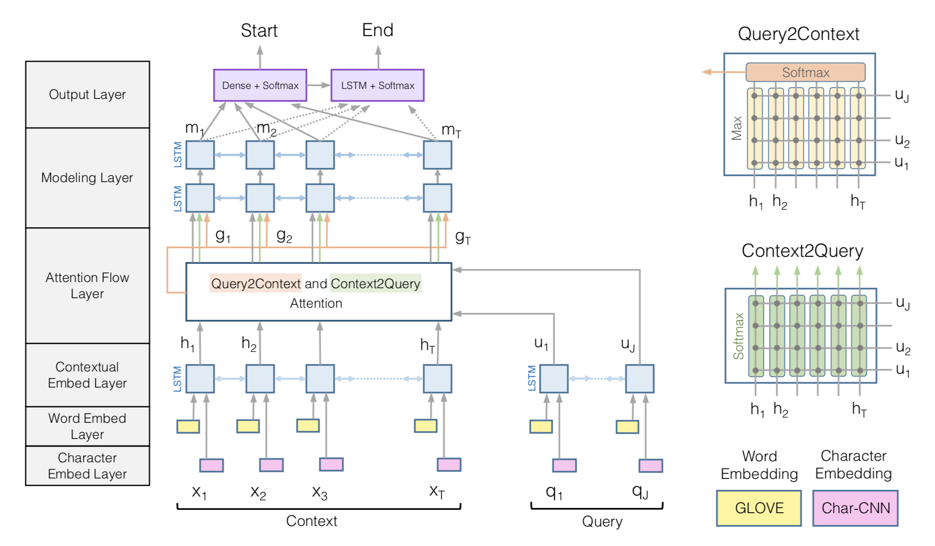
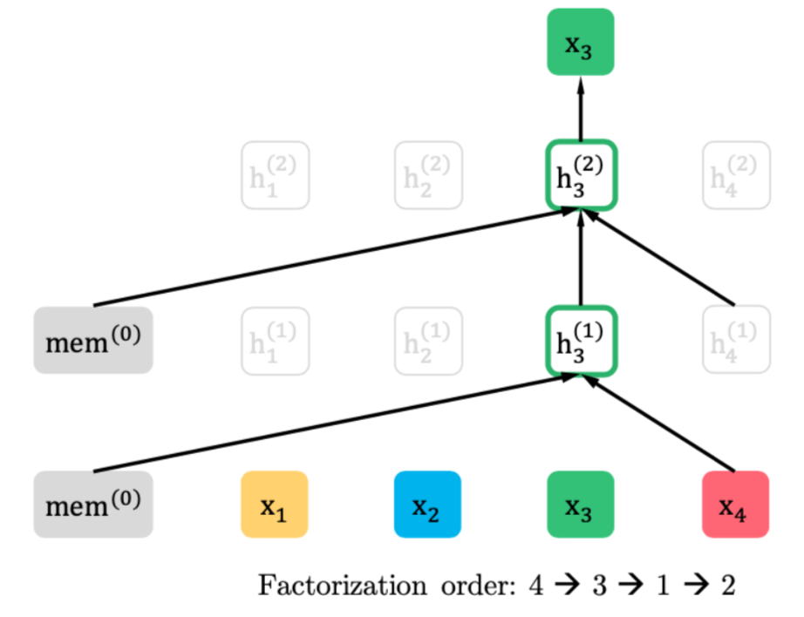
Recent Progress: BIDAF, BERT
reading comprehension: target at understanding the whole paragraph
BiDAF
BERT
XLNet
Rajpurkar, Pranav, et al. "SQuAD: 100,000+ Questions for Machine Comprehension of Text." EMNLP. 2016.

Slide 40
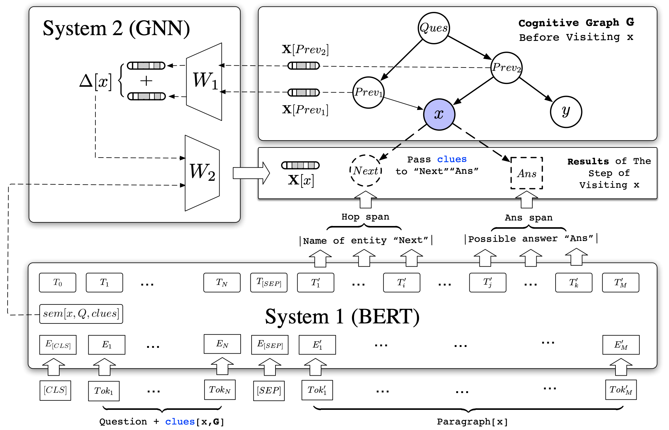
Cognitive Graph: DL + Dual Process Theory
?
System 2: explicit decision
System 1: implicit knowledge expansion
M. Ding, C. Zhou, Q. Chen, H. Yang, and J. Tang. Cognitive Graph for Multi-Hop Reading Comprehension at Scale. ACL’19.

Slide 41
Cognitive Graph: Representation, Reasoning, and Decision
?
Notes:
Imagine a scenario where you have a wikipedia to look up for any entity, and how can you answer such a question?(click)
Question…
We will first search quality café and los angeless which seems useful for answering the question. Okay there are two quality café but we find CLUES in the middle one there are two films featured here. And then we read the paragraph in wiki about the two films and find out there directors.
Now, we construct a graph step by step, which includes all possible and userful information. And our brain will analyze the whole information and gives the final answer.
We name this graph “cognitive graph”.

Slide 42
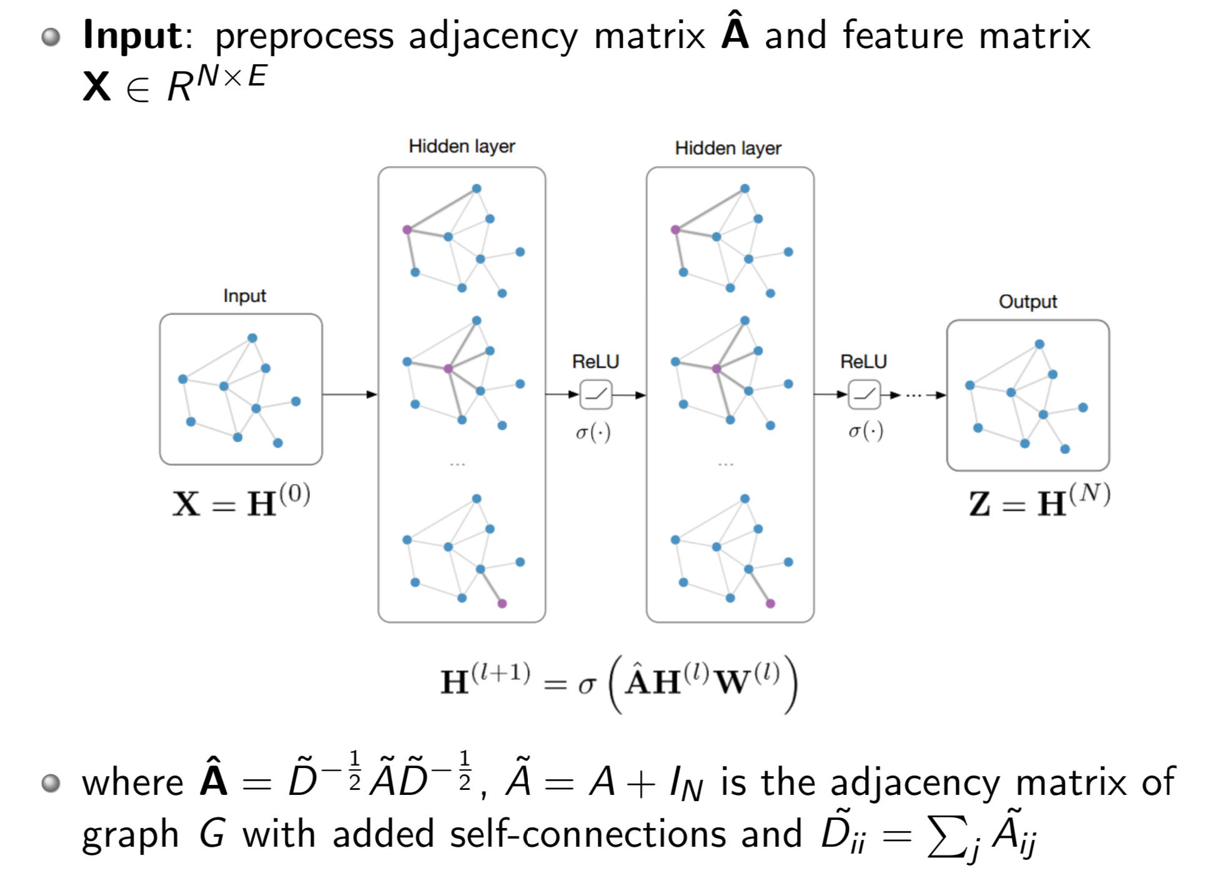
GNN/GCN Model Architecture

Slide 43
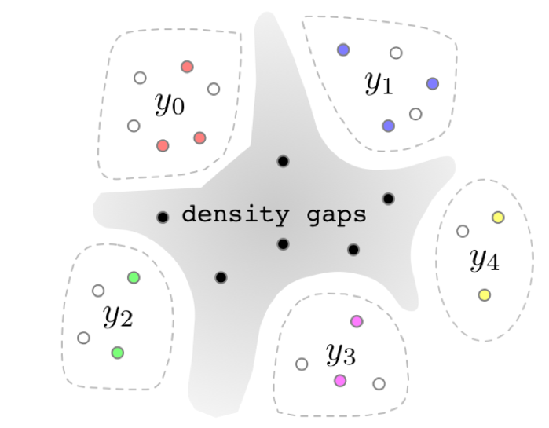

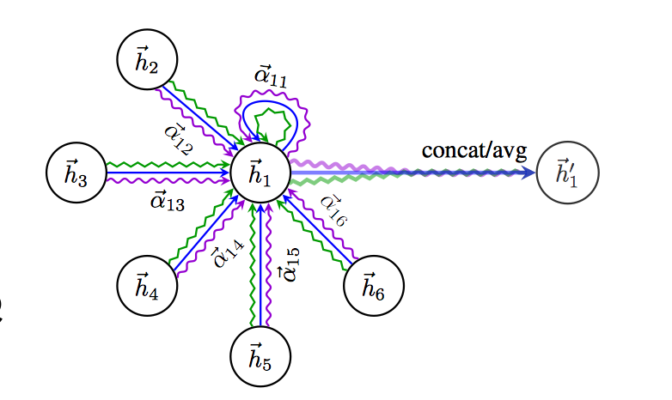


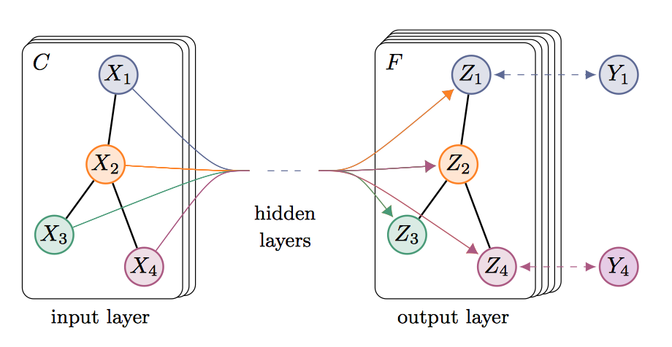
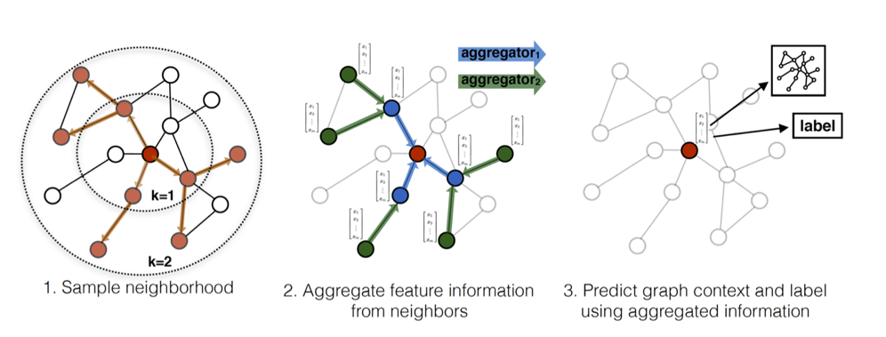
Recent GCN Research
2018
GraphSGAN
FastGCN
2018
2018
GAT
GraphSAGE
2017
2017
GCN

Slide 44
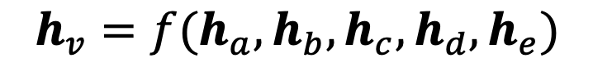
The Core of Graph Neural Networks
a
b
$$h_{v}=f(h_{a}, h_{b}, h_{c}, h_{d}, h_{e})$$
v
c
e
d
Neighborhood Aggregation:
Aggregate neighbor information and pass into a neural network

Slide 45
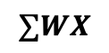
Graph Neural Networks
a
b
$$h_{v}=f(h_{a}, h_{b}, h_{c}, h_{d}, h_{e})$$
v
c
e
d
$$∑WX$$
Neighborhood Aggregation:
Aggregate neighbor information and pass into a neural network
It can be viewed as a center-surround filter in CNN---graph convolutions!

Slide 46
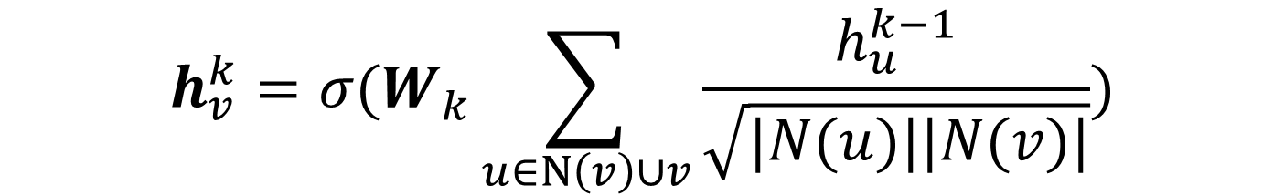
GNN: Graph Convolutional Networks
a
b
$$h_{v}^{k}=σ(W_{k}\sum_{u∈N\left(v\right)∪v}{\frac{h_{u}^{k−1}}{\sqrt{|N(u)||N(v)|}}})$$
v
c
e
d
Kipf et al. Semi-supervised Classification with Graph Convolutional Networks. ICLR 2017

Slide 47
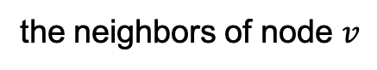
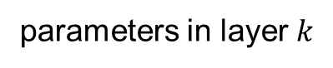

GNN: Graph Convolutional Networks
parameters in layer $k$
a
b
Non-linear activation function (e.g., ReLU)
$$h_{v}^{k}=σ(W_{k}\sum_{u∈N\left(v\right)∪v}{\frac{h_{u}^{k−1}}{\sqrt{|N(u)||N(v)|}}})$$
v
c
e
d
node $v$’s embedding at layer $k$
the neighbors of node $v$

Slide 48

GraphSAGE Model Arthitecture
Hamilton et al. Inductive Representation Learning on Large Graphs. NIPS 2017

Slide 49

GraphSage
GCN
$$h_{v}^{k}=σ(W_{k}\sum_{u∈N\left(v\right)∪v}{\frac{h_{u}^{k−1}}{\sqrt{|N(u)||N(v)|}}})$$
a
b
v
c
e
GraphSage
d
$$h_{v}^{k}=σ({[A}_{k}⋅AGG\left(\left\{h_{u}^{k−1}, ∀u∈N\left(v\right)\right\}\right), B_{k}h_{v}^{k−1}])$$
Generalized aggregation: any differentiable function that maps set of vectors to a single vector
Hamilton et al. Inductive Representation Learning on Large Graphs. NIPS 2017
Slide snipping from “Hamiltion & Tang, AAAI 2019 Tutorial on Graph Representation Learning”

Slide 50
GraphSage
GCN
$$h_{v}^{k}=σ(W_{k}\sum_{u∈N\left(v\right)∪v}{\frac{h_{u}^{k−1}}{\sqrt{|N(u)||N(v)|}}})$$
a
b
v
c
e
GraphSage
Instead of summation, it concatenate neighbor & self embeddings
d
$$h_{v}^{k}=σ({[A}_{k}⋅AGG\left(\left\{h_{u}^{k−1}, ∀u∈N\left(v\right)\right\}\right), B_{k}h_{v}^{k−1}])$$
Generalized aggregation: any differentiable function that maps set of vectors to a single vector
Hamilton et al. Inductive Representation Learning on Large Graphs. NIPS 2017
Slide snipping from “Hamiltion & Tang, AAAI 2019 Tutorial on Graph Representation Learning”

Slide 51
Graph Attention Networks
a
b
v
Realistically, neighbors play different influences
c
e
d
Velickovic et al. Graph Attention Networks. ICLR 2018

Slide 52

Graph Attention Networks
GCN
$$h_{v}^{k}=σ(W_{k}\sum_{u∈N\left(v\right)∪v}{\frac{h_{u}^{k−1}}{\sqrt{|N(u)||N(v)|}}})$$
a
b
v
c
e
Graph Attention
d
$$h_{v}^{k}=σ(\sum_{u∈N\left(v\right)∪v}{α_{v,u}W^{k}h_{u}^{k−1}})$$
Learned attention weights
Velickovic et al. Graph Attention Networks. ICLR 2018

Slide 53

GAT Results

Slide 54
Cognitive Graph: DL + Dual Process Theory
System 2: explicit decision
System 1: implicit knowledge expansion
M. Ding, C. Zhou, Q. Chen, H. Yang, and J. Tang. Cognitive Graph for Multi-Hop Reading Comprehension at Scale. ACL’19.

Slide 55




System 1: the BERT Implementation
Extract top-k next-hop entities and answer candidates respectively
Predict the start and end probabilities of each position
Generate semantic vectors for entities based on their documents
Take the 0-th probability as negative threshold
Ignore the spans whose start probabilities are small than the negative threshold

Slide 56



System 2: the GNN implementation
At each step, hidden representations X for nodes are updated according to the propagation rules:
Predictor F is a two-layer MLP, which predicts the final answer based on hidden representations X:

Slide 57

CogQA Algorithm and Training
Preprocess
Mark the spans of next-hop entities and answer by fuzzy matching
Golden cognitive graph and negative (hop and span) nodes
Train Task #1 (System 1)：
Next-hop spans and answer spans extraction
Train Task #2 (System 1 & 2)：
Prediction with GNN

Slide 58

Performance
HotpotQA is a dataset with leaderboard similar to SQuAD
CogQA ranked 1st from 21, Feb to 15, May (nearly 3 month)
** Code available at https://github.com/THUDM/CogQA
Notes:
Two things to note:
Yang-IR: improved retrieval. We improve the retrieval process of Yang et al. for better comparison.
CogQA-onlyQ is designed that it only starts with the entities that appear in the question.
Free of elaborate retrieval methods, this setting can be regarded as a natural thinking pattern of human being, in which only explicit and reliable relations are needed in reasoning. CogQA-onlyQ still outperforms all the baselines

Slide 59
Reasoning Power
CogQA Performs much better on question with more hops！
Notes:
CogQA Performs much better on question with more hops

Slide 60
Case Study
Tree-shape Cognitive Graph
Users can verify the answer by comparing it with another possible reasoning chain.
“Upper House” in the question is similar to “Senate” not “House of Representative”
Notes:
We show how the cognitive graph clearly explains complex reasoning processes in our experiments.
The cognitive graph highlights the heart of the question in case (1) – i.e., to choose between the number of members in two houses. CogQA makes the right choice based on semantic similarity between “Senate” and “upper house”.
Case (2) illustrates that the robustness of answering can be boosted by exploring parallel reasoning paths.
In Case (3) our model finally gets the answer “Marijus Adomaitis” while the annotated ground truth is “Ten Walls”. However, when backtracking the reasoning process in cognitive graph, we find that the model has already reached “Ten Walls” and answers with his real name, which is acceptable and even more accurate. This is why we need explainability.

Slide 61
Case Study
DAG-shape Cognitive Graph
Multiple supporting facts provides richer information, increasing the credibility of the answer.

Slide 62
Case Study
CogQA gives the answer “Marijus Adomaitis” while the ground truth is “Ten Walls”.
By examining, Ten Walls is just the stage name of Marijus Adomaitis!
Without cognitive graphs, black-box models cannot achieve it.

Slide 63
Summary
Iterative Framework --> Myopic Retrieval
Cognitive Graph --> Explainability
Dual process theory --> System 2 Reasoning
Cognitive graph
CogQA framework

Slide 64


More Applications: KG completion
Completing knowledge graph with cognitive graph

Slide 65
Related Publications
Ming Ding, Chang Zhou, Qibin Chen, Hongxia Yang, and Jie Tang. Cognitive Graph for Multi-Hop Reading Comprehension at Scale. ACL’19.
Jie Zhang, Yuxiao Dong, Yan Wang, Jie Tang, and Ming Ding. ProNE: Fast and Scalable Network Representation Learning. IJCAI’19.
Yukuo Cen, Xu Zou, Jianwei Zhang, Hongxia Yang, Jingren Zhou and Jie Tang. Representation Learning for Attributed Multiplex Heterogeneous Network. KDD’19.
Fanjin Zhang, Xiao Liu, Jie Tang, Yuxiao Dong, Peiran Yao, Jie Zhang, Xiaotao Gu, Yan Wang, Bin Shao, Rui Li, and Kuansan Wang. OAG: Toward Linking Large-scale Heterogeneous Entity Graphs. KDD’19.
Yifeng Zhao, Xiangwei Wang, Hongxia Yang, Le Song, and Jie Tang. Large Scale Evolving Graphs with Burst Detection. IJCAI’19.
Yu Han, Jie Tang, and Qian Chen. Network Embedding under Partial Monitoring for Evolving Networks. IJCAI’19.
Jiezhong Qiu, Yuxiao Dong, Hao Ma, Jian Li, Chi Wang, Kuansan Wang, and Jie Tang. NetSMF: Large-Scale Network Embedding as Sparse Matrix Factorization. WWW'19.
Jiezhong Qiu, Jian Tang, Hao Ma, Yuxiao Dong, Kuansan Wang, and Jie Tang. DeepInf: Modeling Influence Locality in Large Social Networks. KDD’18.
Jiezhong Qiu, Yuxiao Dong, Hao Ma, Jian Li, Kuansan Wang, and Jie Tang. Network Embedding as Matrix Factorization: Unifying DeepWalk, LINE, PTE, and node2vec. WSDM’18.
Jie Tang, Jing Zhang, Limin Yao, Juanzi Li, Li Zhang, and Zhong Su. ArnetMiner: Extraction and Mining of Academic Social Networks. KDD’08.
For more, please check here http://keg.cs.tsinghua.edu.cn/jietang

Slide 66
Thank you！
Collaborators:
Jie Zhang, Ming Ding, Jiezhong Qiu, Qibin Chen, Yifeng Zhao, Yukuo Cen, Yu Han, Fanjin Zhang, Xu Zou, Yan Wang, et al. (THU)
Hongxiao Yang, Chang Zhou, Le Song, Jingren Zhou, et al. (Alibaba)
Yuxiao Dong, Chi Wang, Hao Ma, Kuansan Wang (Microsoft)
Jie Tang, KEG, Tsinghua U http://keg.cs.tsinghua.edu.cn/jietang
Download all data & Codes https://keg.cs.tsinghua.edu.cn/cogdl/
https://github.com/THUDM

